Slide 1
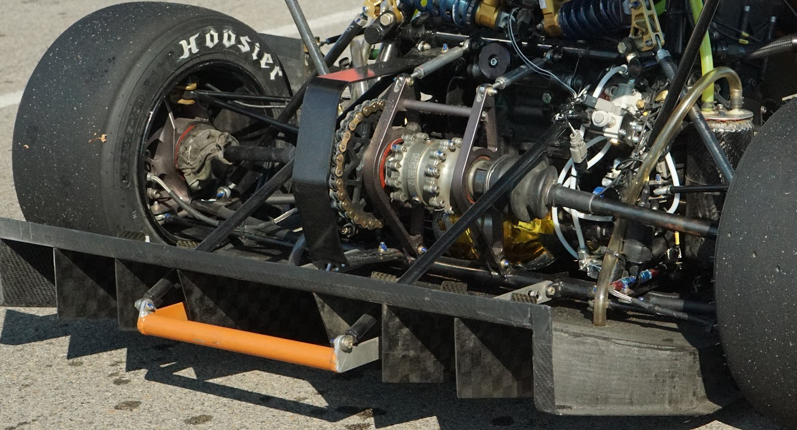
Purdue FSAE – Drivetrain CDR
Sidh Gurnani
10/02/2024

Slide 2
Table of Contents
Changes Since Last Review
Rules
CAD
Mass
Philosophy
Trades
Design
Analysis
Manufacturing
Cost

Slide 3
Changes Since Last Review
List all changes made since PDR
These include but are not limited to changes to design criteria, loads, architecture, analysis…
Go through PDR feedback and show how you addressed each point of feedback

Slide 4
Changes Since Last Review

Slide 5
Changes Since Last Review
Changes since PDR:
CAD
Diff Carrier Cutouts
Modeled max chain stretch
Done by expression, where the top node, diff axis move when the turnbuckle is “extended”
Temporary Tabs in Layout
Analysis
Bolt + Lug Calcs
Final FEA → Sprocket, CV Inserts
WIP → Turnbuckles and Diff Carriers

Slide 6
Changes Since Last Review
Changes since PDR (by component):
Final Drive Ratio
FDR set at 31/12
Differential
Differential moved 0.27 in forward to ensure an even number of links in chain
Sprocket
Revised boundary conditions in FEA
Mesh Convergence
Mass optimization
Diff Carriers
Ran individual FEA + combined FEA
Mesh Convergence in progress
Mass Optimization in progress

Slide 7
Changes Since Last Review
Changes since PDR (by component):
CV Inserts
Material changed to Custom 465
FEA + Hand Calculations
Reoriented to work with Hubs CAD
Turnbuckles
Optimized angle to reduce loading
FEA + Hand Calculations
Chain Guard
No changes made since PDR due to allocation of my resources elsewhere

Slide 8
Changes Since Last Review
Changes since PDR (by component):
Misc
Hardware in CAD
Tabs in CAD
Mass Properties in CAD
Loads appropriately sourced for bolt/lug calcs
Will dive later into this…

Slide 9
Changes Since Last Review
PDR Feedback:
Check max accel g forces, maybe not 1.65
Sticking with 1.65, went back and forth about it while deriving CV Insert loading
Margin on sprocket is sus yield or ultimate?
Shear stress SF → ultimate
Compressive SF and Tensile Yield → yield
Margin reporting is confusing why is it this way?
This mainly has to do with an “allowable” value not being properly defined in some situations (i.e. spline stresses) thus SF is used instead
How to determine amount of press fit for bearings (shigleys tables)
For now I am sticking with 0.001 in accordance to what NTN recommends, but I believe it should be more than that, around 1.5 to 2 thou.

Slide 10
Changes Since Last Review
PDR Feedback (cont’d):
Why are we using 1.2 on carriers
The SF for carriers can be lowered to 1.1 yield and 1.4 ultimate, but the sprocket is something I have designed to 1.4 ultimate (and 1.2 yield)
Engine and carrier tab is concerning
Should be resolved now after playing around with different tab angles
Rod ends?
Remains an open item for now as the most realistic option is to use the ones from McMaster Carr

Slide 11
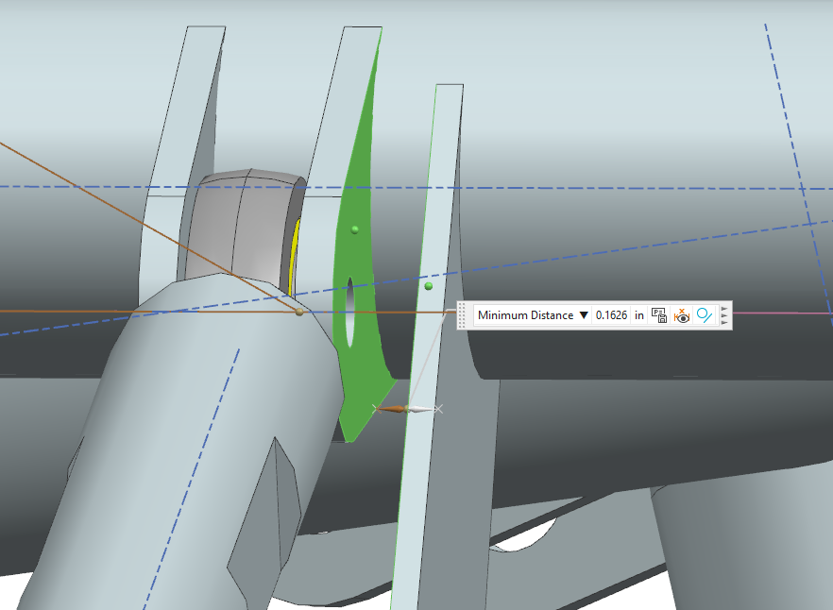
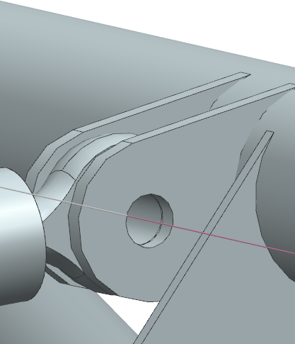
Changes Since Last Review
Notes:
Engine Tab Situation

Slide 12
Rules

Slide 13
Rules
Rule | Exact Text | Requirements From Rule
T.5.1 | Any transmission and drivetrain may be used. | Any configuration can be used as team sees fit. Must comply with rest of rules below.
T.5.2.1 | Exposed high speed final drivetrain equipment such as Continuously Variable Transmissions (CVTs), sprockets, gears, pulleys, torque converters, clutches, belt drives, clutch drives and electric motors, must be fitted with scatter shields intended to contain drivetrain parts in case of radial failure. | Drivetrain system must contain "shield" (i.e. Chain Guard) to prevent exposed parts from scattering (i.e. Sprocket, Chain).

Slide 14
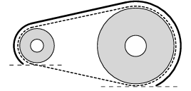
Rules
Rule | Exact Text | Requirements From Rule
T.5.2.2 | The final drivetrain shield must: a. Be made with solid material (not perforated) b. Cover the chain or belt from the drive sprocket to the driven sprocket/chain wheel/belt or pulley c. Start and end no higher than parallel to the lowest point of the chain wheel/belt/pulley d. Cover the bottom of the chain or belt or rotating component when fuel, brake lines T.3.1.8, control, pressurized, electrical components are located below | Final guard must be made of a solid material and cover the sprocket-chain system as shown in the image.
T.5.2.3 | Body panels or other existing covers are acceptable when constructed per T.5.2.7 / T.5.2.8. | Body panels can be used as part of the guard system if constructed to rules specification.
T.5.2.4 | Frame Members or existing components that exceed the scatter shield material requirements may be used as part of the shield. | Existing frame members and/or components can be used as long as they EXCEED material requirements

Slide 15
Rules
Rule | Exact Text | Requirements From Rule
T.5.2.5 | Scatter shields may be composed of multiple pieces. Any gaps must be small (< 3 mm). | Guard system can be made of multiple components if gaps are small (i.e. less than 3 mm).
T.5.2.6 | If equipped, the engine drive sprocket cover may be used as part of the scatter shield system. | OEM guards can be used.
T.5.2.7 | Chain Drive - Scatter shields for chains must: a. Be made of 2.66 mm (0.105 inch) minimum thickness steel (no alternatives are allowed) b. Have a minimum width equal to three times the width of the chain c. Be centered on the center line of the chain d. Stay aligned with the chain under all conditions | For chain driven systems (what we historically run), the following must be met: Made of 0.105 inch minimum thick steel Overall width equal to 3 times width of chain Centered along center line of chain at all times Stay aligned with chain under all conditions
T.5.2.9 | Attachment Fasteners - All fasteners attaching scatter shields and guards must be 6 mm or 1/4” minimum diameter Critical Fasteners, see T.8.2 | All fasteners used in guard system must be in accordance to T.8.2

Slide 16
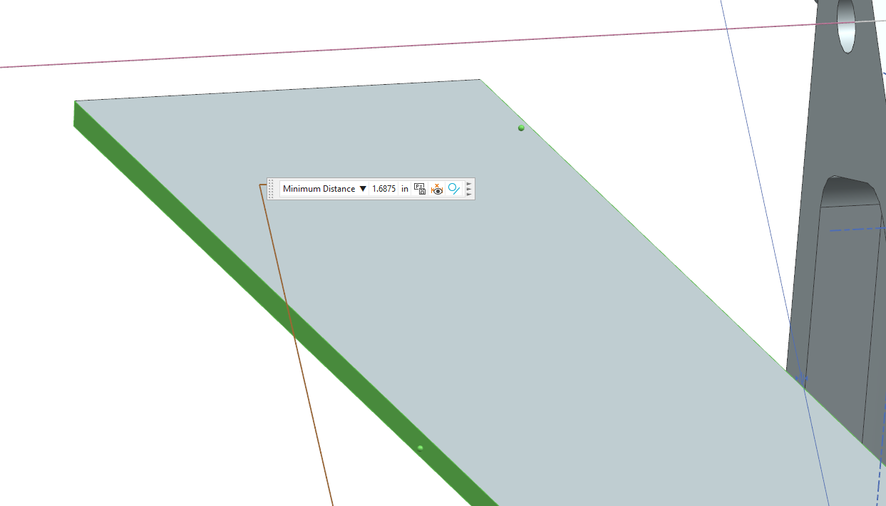
Rules
Rule | How Satisfied?
Chain Guard Width
Work in Progress

Slide 17
Rules
Demonstrate how you satisfied each rule related to your system using images, measurements, etc.
Rule | How Satisfied?

Slide 18
CAD

Slide 19
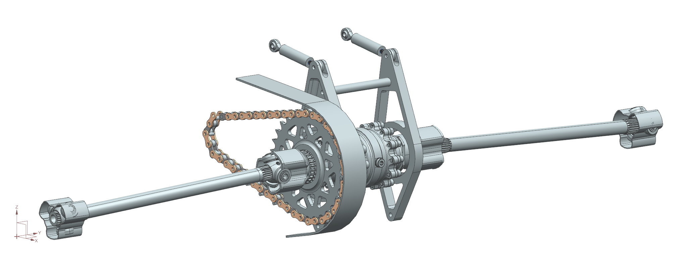
CAD
Turnbuckles
CV Inserts
CV’s (Tripods)
Halfshafts
Front Sprocket
Chain
Rear Sprocket
Differential Carriers
Differential
Chain Guard
Inboard Tripod Housing (Tulips)
12. Boots (not pictured)
1
10
11
5
3
4
9
12
6
2
7
8

Slide 20
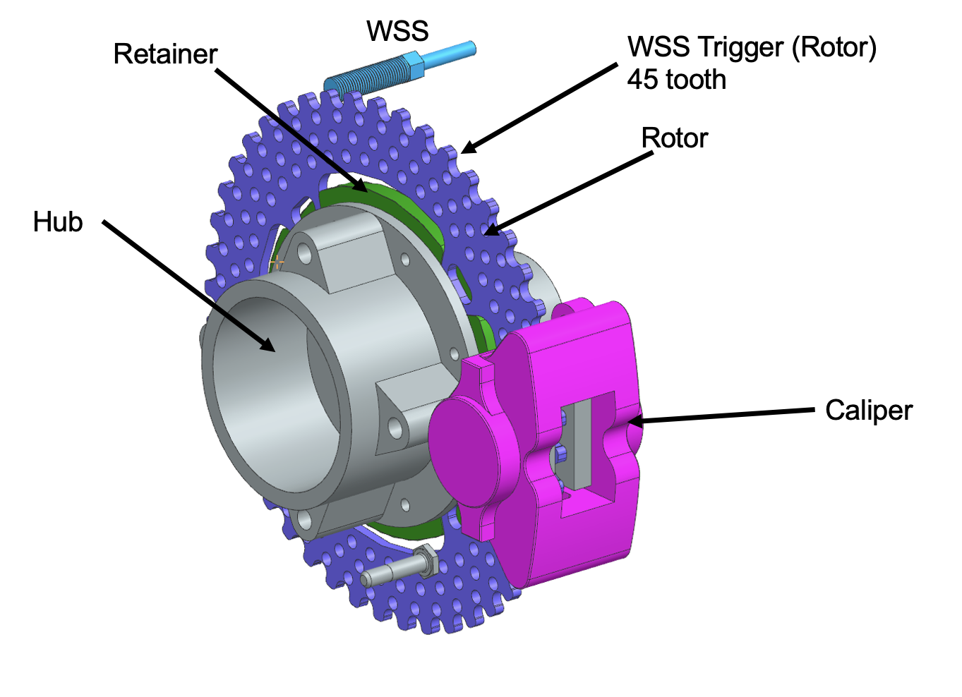
CAD
Present labeled images of your CAD
Highlight areas of cross-system interaction and packaging concern
Place emphasis on areas that will give the attendees a good high-level view of your designed system

Slide 21
Mass

Slide 22
Mass
Component | PF24 Masses (lbm) | PF25 Masses (lbm)
Left Carrier | 0.6012 | 0.8080
Right Carrier | 0.3445 | 0.5894
Turnbuckles | 0.1853 | 0.2455 (body + rodends) x2
Stability Bar | 0.0893 | ~0.0893
Sprocket | 0.447 | 0.5093
Sprocket Spacer | 0.069 | ~0.069
Chain | 1.5742 | ~1.43 (blind guess)
Chain Guard | 2 | ~2 (WIP)
Tripods | 1.32 | 1.32
CV Inserts | 0.3628 | 0.3628
Halfshafts | 3.99 | 3.1055
Differential | 10.85 | 10.85
Hardware | 0.2624275 | ~0.25 (no towbar)
Tabs | 1 | ~1
Total | 23.0957275 | 22.6288
Take with a grain of salt

Slide 23
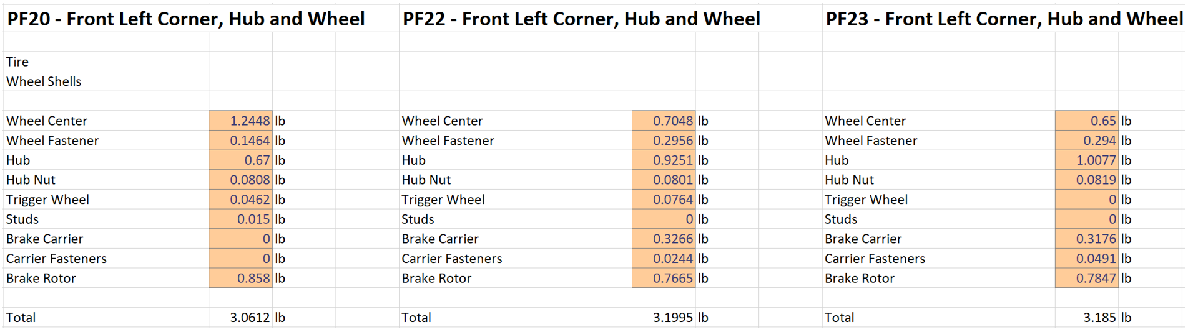
Mass
Present system mass by component and compare to previous years (ensure that CAD reflects these masses)
State how/why things are significantly lighter or heavier than they were in the past

Slide 24
Philosophy

Slide 25
Philosophy
Driver Centered Design
Using a differential for ease of driving as well as predictability
Designed, to an extent, with serviceability to maximize track time
Low, Light, Tight
Differential moved as far forward and down as possible without interference to the frame (from the halfshafts)
Mass optimization on sprocket, diff carriers carried out

Slide 26
Philosophy
Vehicle Goals:
Driver Safety
System designed to a factor of safety which is AT THE MINIMUM team standards, with conservative estimates and setups to add a buffer
System Reliability
Utilize combination of sprockets that minimizes wear on sprockets
Replace components as needed, determined by visual inspection
Max Comp Points
Mass reduced where possible, while ensuring safety standards
Accommodate FDR to allow team to be as competitive as possible
Positioning differential closer to CG
Driver Confidence/Comfort
No major failures during lifetime of the vehicle
Find and set up a tune for a differential that yields no driver complaints (and one that doesn’t shred the hubs)
Serviceability
Utilize chain tensioning system to adjust chain tension in under two minutes (turnbuckles)
Accommodating space needed for appropriate tools for servicing

Slide 27
Philosophy
Explain how your design decisions relate to the vehicle philosophy & goals
Driver Centered Design
Low, Light, and Tight
Vehicle Goals

Slide 28
Trades

Slide 29
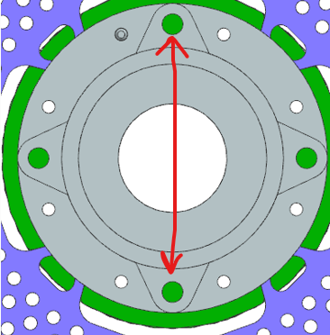
Trades
Outline all vehicle and system level trades related to your system.
Ex. tradeoff between hub lug spacing (Larger – increase stiffness and mass, Smaller – decrease stiffness and mass)

Slide 30
Trade #1 – Diff Placement
Differential had to be moved post-IDR to achieve an even number of links due to final drive changes
Option #1 – Move diff towards front of car
Allows even number of links to be achieved
Tighter packaging (may have necessitated with architecture)
Has an effect on CHA clearances
Halfshaft angles go down (and subsequently a small amount of length)
Option #2 – Move diff towards rear of car
Allows even number of links to be achieved
Much looser packaging
Diff carriers would have to be upsized
Turnbuckles would be longer (slightly more prone to buckling)
Halfshaft angles go up (and subsequently a small increase in length)

Slide 31
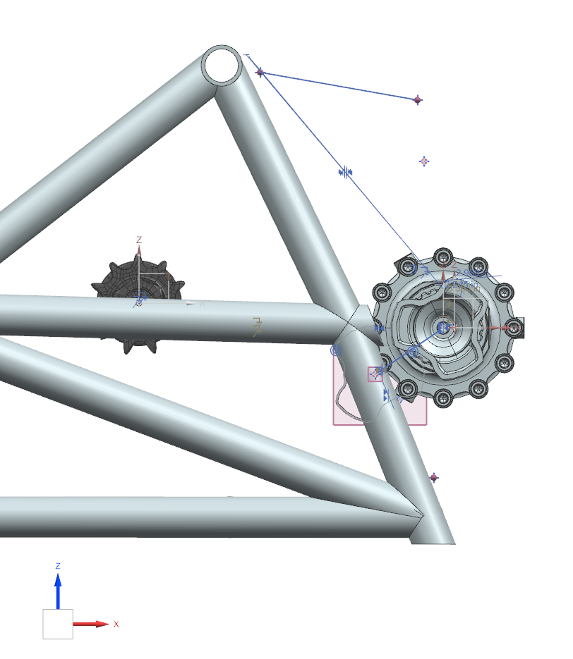
Trade #1 – Diff Placement

Slide 32
Trade #2 – Diff Carrier Top Node
Placement of top node can have an affect on loading through turnbuckles and diff carriers (as well as any hardware) → study carried out on hand calcs
Option #1 – Move top node down
Smaller diff carrier → less mass optimization
Increases loading at the top node
Option #2 – Move top node up
Larger diff carrier → more mass to optimize
Decreases loading at the top node

Slide 33
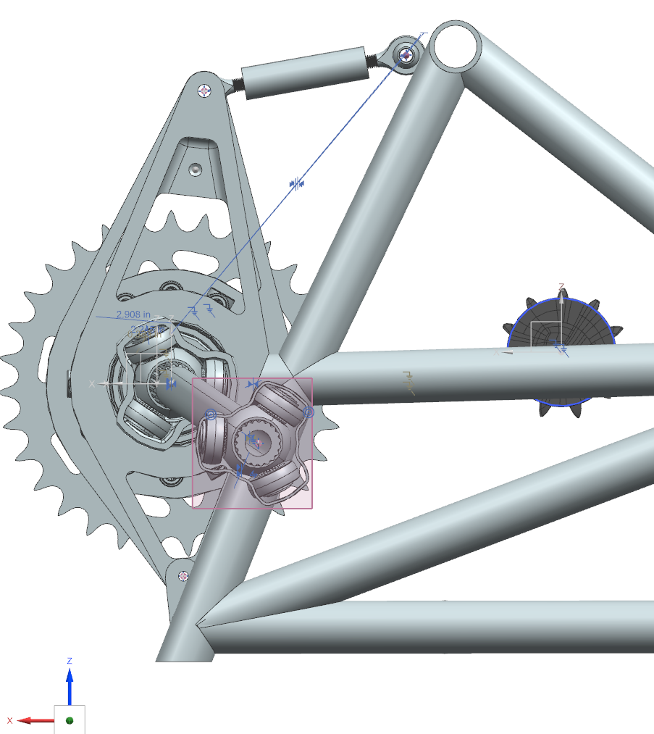
Trade #2 – Diff Carrier Top Node

Slide 34
Design

Slide 35
Design
Architectural Item | Description (if needed)
Differential | Drexler Limited Slip Differential
Chain Tensioning System | Turnbuckles (custom made body with sourced rod ends) Goal is to accommodate about 3% of chain tension
CV Inserts | Custom, PF20 Special Material change to Custom 465 Steel
CV’s (Tripods) | Purchased RCV
Halfshafts | Purchased RCV Lengths (L/R) – 15.95 in / 18.70 in Angles (L/R) – 7.6437 deg / 6.447 deg
Chain | DID 520 Roller Chain
Rear Sprocket | Custom made; This year modeled in CAD to resemble real life more
Differential Carriers | Custom made
Tulips | Using one short, one long and will slide into diff
Boots | Purchased (or higher fidelity custom)
Chain Guard | Custom; 0.105 in thick steel

Slide 36
Design
Architectural Item | Why?
Differential | Good for drivability; good history with using despite the weight it carries
Chain Tensioning System | Turnbuckles provides a simpler solution compared to the other alternatives (idler sprocket, eccentric diff carriers)
CV Inserts | Material change necessitated given new assumptions made about loading and failures from PF24
CV’s (Tripods) | Purchased RCV; used extensively
Halfshafts | Purchased from RCV (as we are using tripods from them)
Chain | Compatible with front sprockets at our disposal
Rear Sprocket | Made custom to work for a variety of situations (generally speaking) Al for machining and because of metallurgical compatibility with other metals
Differential Carriers | Made custom to work with our situation Al for machining (and budget since Arconic)
Tulips | Work with our current diff
Boots | Better sourcing avoids issues of PF24
Chain Guard | Made to rules spec

Slide 37
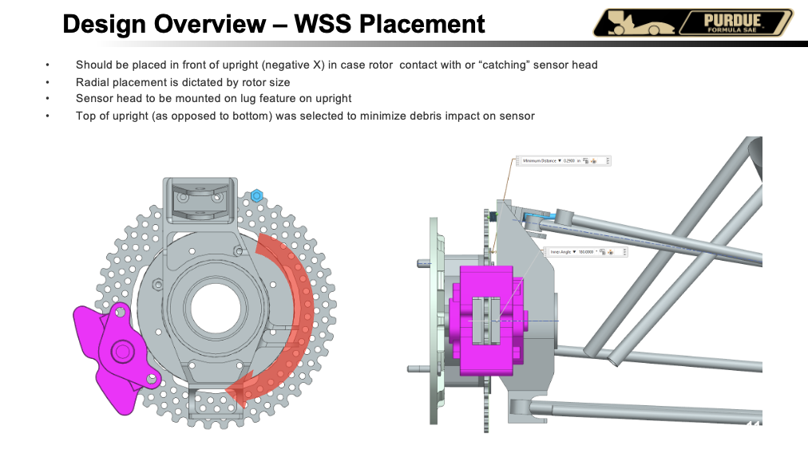
Design
Overview your final design
List system specifications, architecture, and any concerns moving forward
In conjunction with Analysis discuss all major justification that you have for component selection/placement, material choice, geometry, etc…

Slide 38
Analysis

Slide 39
Analysis – Flow Map
Vehicle Accel
Engine Torque
Chain Force
Sprocket Force
Diff Carriers
Halfshafts
Sprocket Teeth
Turnbuckles
CVs/CV Inserts
Tabs

Slide 40
Analysis - Global Inputs
Vehicle Parameters
Vehicle weight, tire diameter, max accel
Sprocket Parameters
Number of teeth, FDR, pitch, etc
Launch Parameters
1st gear, 2nd gear

Slide 41
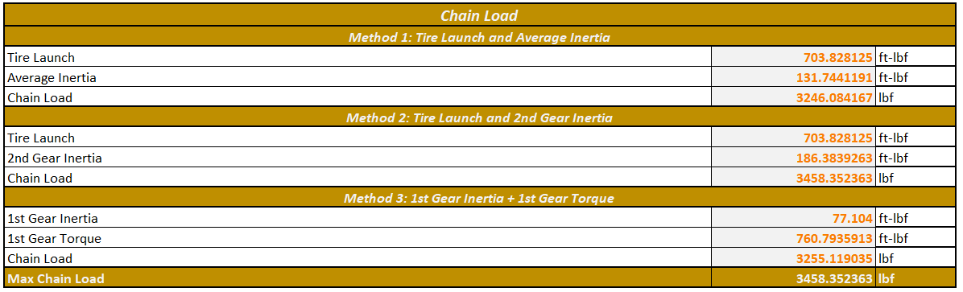
Analysis – Chain Force
Three methods to determine chain force
Max of these three methods is taken as the load going through chain
PF25 → Tire Launch and 2nd Gear Inertia

Slide 42
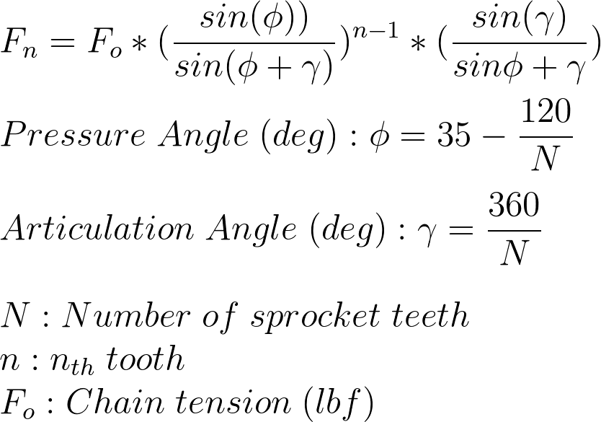
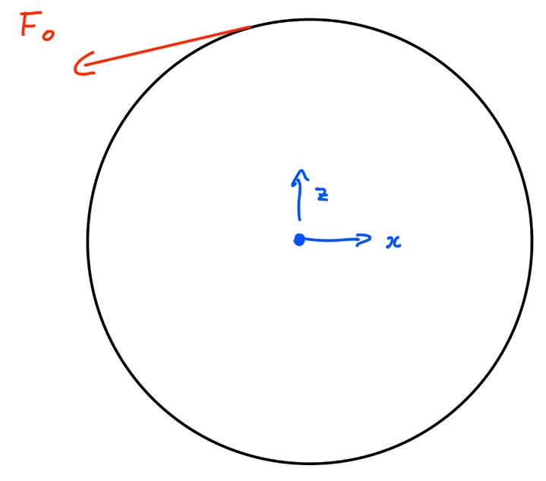
Analysis – Sprocket Force
Using equations (RC Binder Chain Calcs) and the input (chain force) the force on each tooth can be determined.
Coordinate system provided below for reference

Slide 43
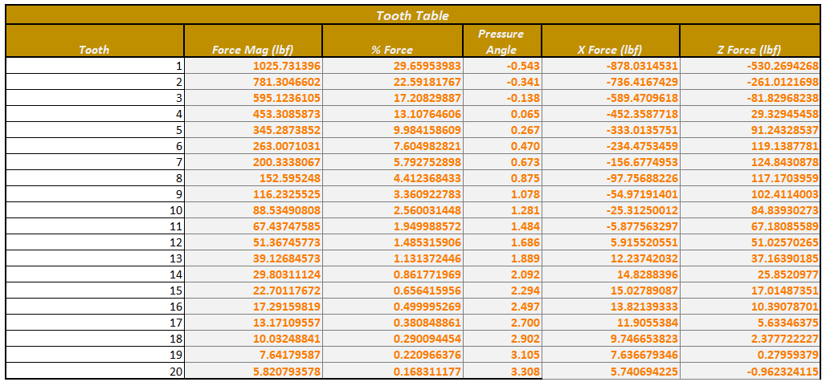
Analysis – Sprocket Force

Slide 44
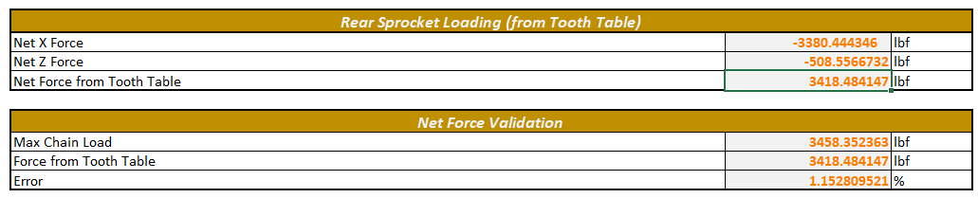
Analysis – Sprocket Force
First 7 teeth put into ANSYS to a significant portion of the loading (defined as a percentage of the max chain load)
Table below displays error between using first 7 teeth vs all teeth in ANSYS

Slide 45
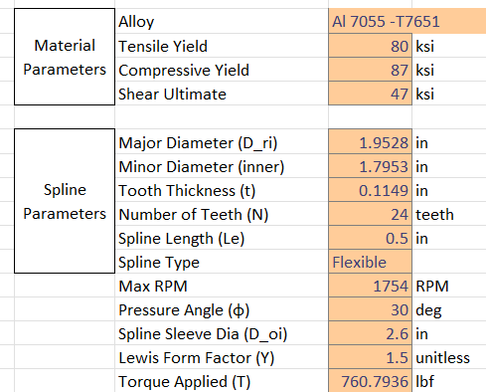
Analysis – Sprocket Force
Top image shows the inputs in spline stress calculator
Sprocket from last time has been thickened from 0.467in to 0.5in
Bottom image shows safety factors
Shear Stress SF → Yield
Compressive SF → Ultimate
Tensile Yield SF → Yield
Reminder this is worst case torque (760 lbf-ft)

Slide 46
Analysis – Diff Carriers Force
Beam calculation is carried out on the sprocket and carrier system to find loads
Statics on 3 node model to get forces at the nodes
I personally think these loads are not super representative since the load applied is a point load as opposed to a bearing load → used ANSYS + probe to get loads on bolts and tabs

Slide 47
Analysis – Bolt/Lug Calcs
Unfortunately, I am blocked by ANSYS at this point
I do not want to use values in tables, since they are not 100% representative of what is actually occurring (in my mind)
Without a combined case (will explain later) I am not able to properly source bolt and lug loads

Slide 48
Analysis – CV Insert Force
Unlike previous few seasons, contact patch is assumed to be 2/3 rollers at launch
Load has gone up significantly since that time, hence necessitating the switch to a much stronger type of steel

Slide 49
Analysis – CV Insert Force
With the new steel being used, much higher SF is achieved (yield)
Worst case SF for CV Insert is ~1.199 at a location 0.008 into the insert

Slide 50
Analysis – Turnbuckles
Ideally would use values from ANSYS, but used highest force for no margin
If ANSYS loads exceed this value, then there could be an issue (however, trade study was carried out to reduce forces)
Input load was 2000 lbf
Tensile/Compressive doesn’t matter

Slide 51
Analysis
Outline all of your completed analysis
Vehicle/Driver Performance
Lapsim
YMD studies
Structures
Hand Calcs (Lug, Bolt, etc.)
Margins Overview (NOT THE ENTIRE CALCULATOR IF TEAM STANDARD)
FEA Setup
FEA Results
Stress & Deformation
Fatigue & Temp Knockdown Derivations
Motion Studies

Slide 52
FEA

Slide 53
FEA – CV Inserts
Notes
FEA will display a stress level near infinite due to the nature of contact stresses for a cylinder and a plane converging at a line
FEA can be used to find the max depth of stress and compare to hand calculations performed

Slide 54
FEA – CV Inserts
Setup:
Quarter tire model
A quarter of roller, CV housing, and mock hub are modeled (to ease meshing and solve time)
Support
Cylindrical Support and Frictionless Support used to support the “hub” in place
Loads
¼ of the load seen according to CV Insert Loads calculator is applied to the quarter roller

Slide 55
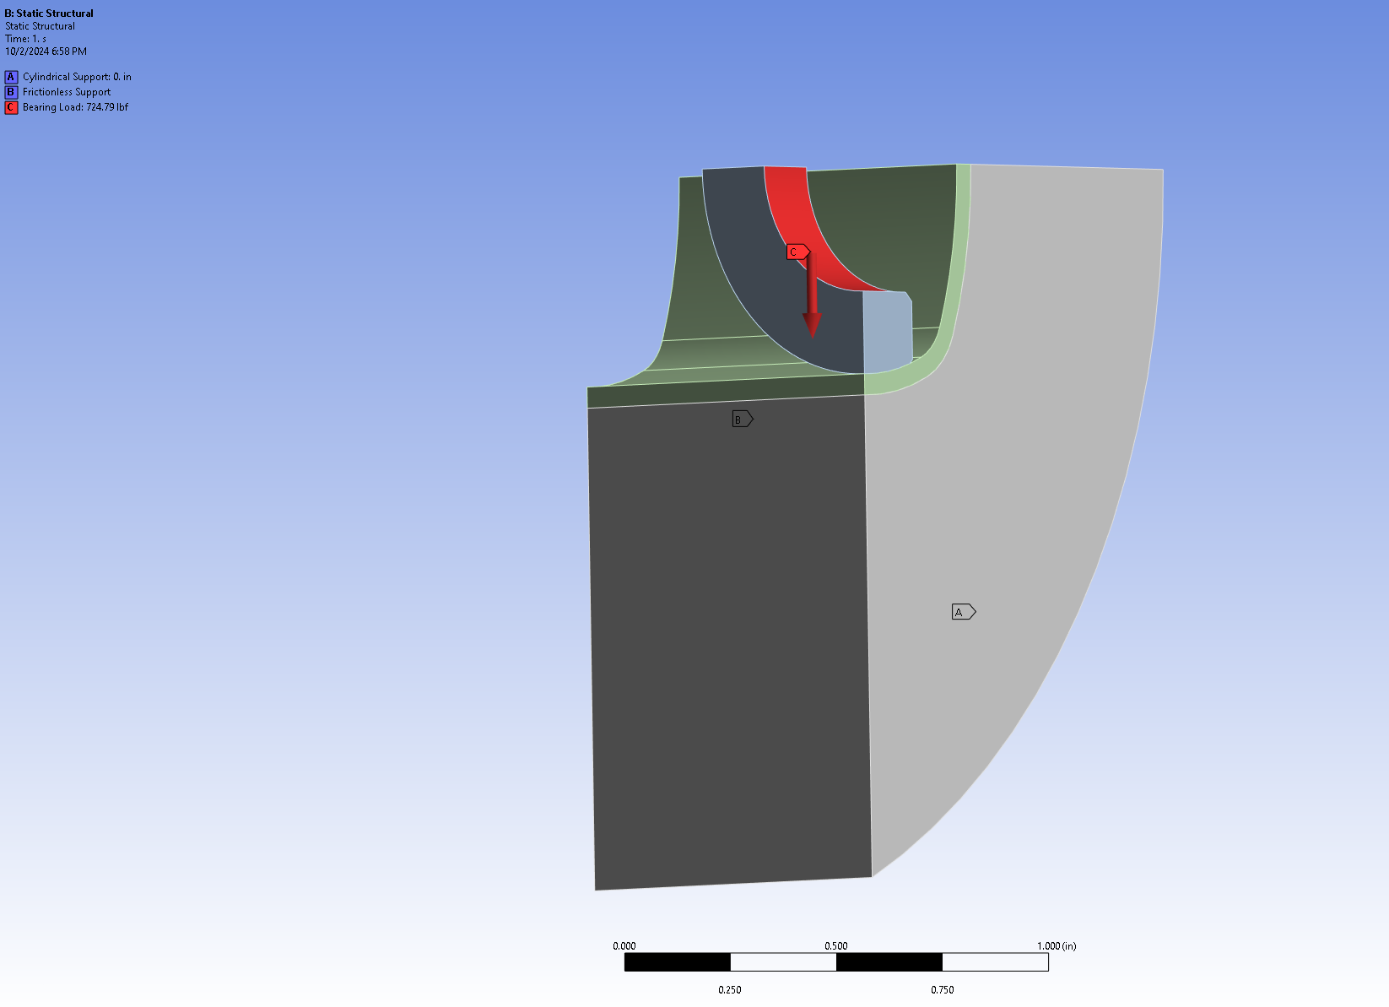
FEA – CV Inserts

Slide 56
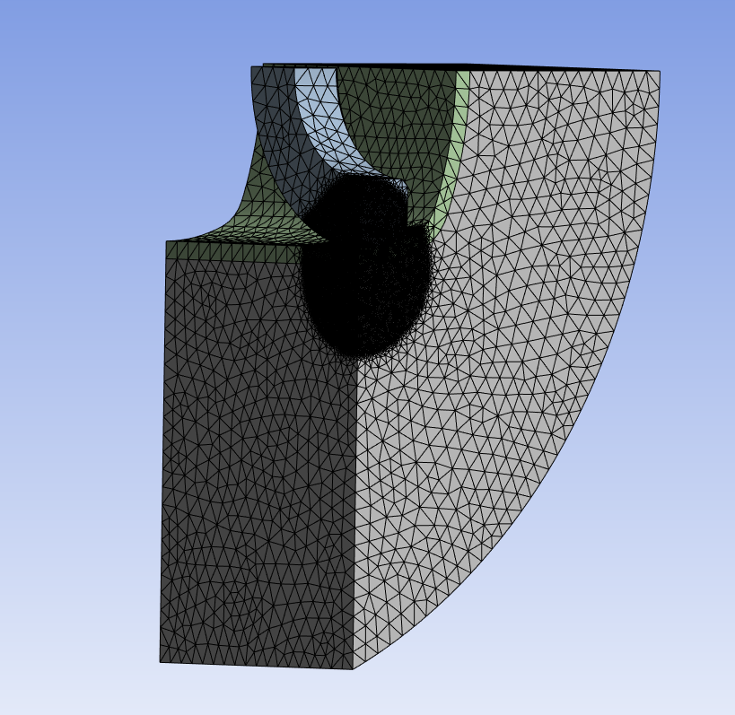
FEA – CV Inserts
Mesh:
General Parameters
Element Size = 0.05 in
Quadratic Element Order
Sphere of Influence and Contact Sizing
Better mesh on contact surfaces

Slide 57
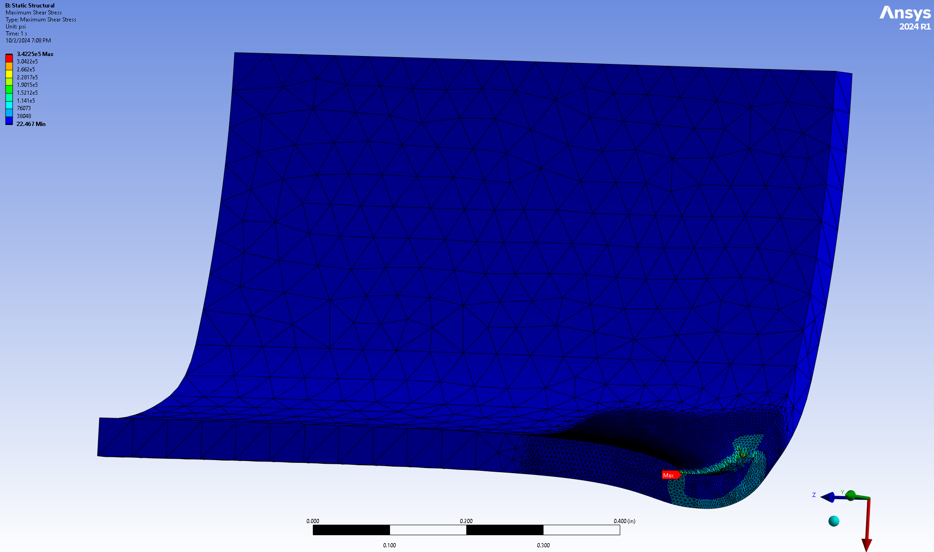
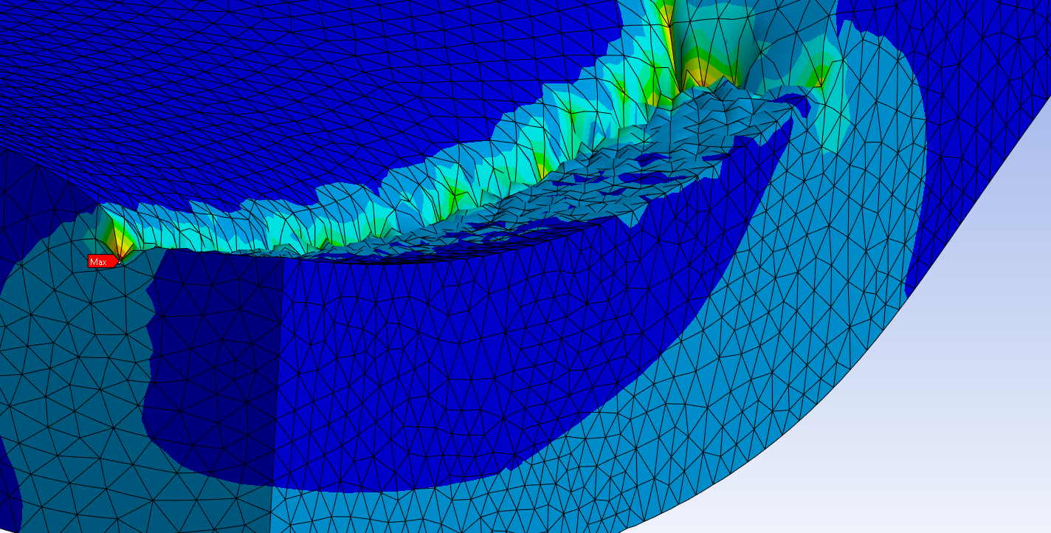
FEA – CV Inserts
Load Case: Launch | Solver: Ansys | Material: Custom 465 | Geometry: Linear
Safety Factor Ultimate: 1.4 | Safety Factor Yield: 1.1 | Temperature: 71.6 F | Notes:
Section | Max Stress | Failure Mode | Material | Yield Allowable (with knockdowns) | Ultimate Allowable (with knockdowns) | MS_Yield | MS_Ultimate | Jacobian Ratio (Gauss Points) Avg | Aspect Ratio Avg
 |  |  | Steel | 181 ksi |  |  |  | 0.99987 | 1.7889

Slide 58
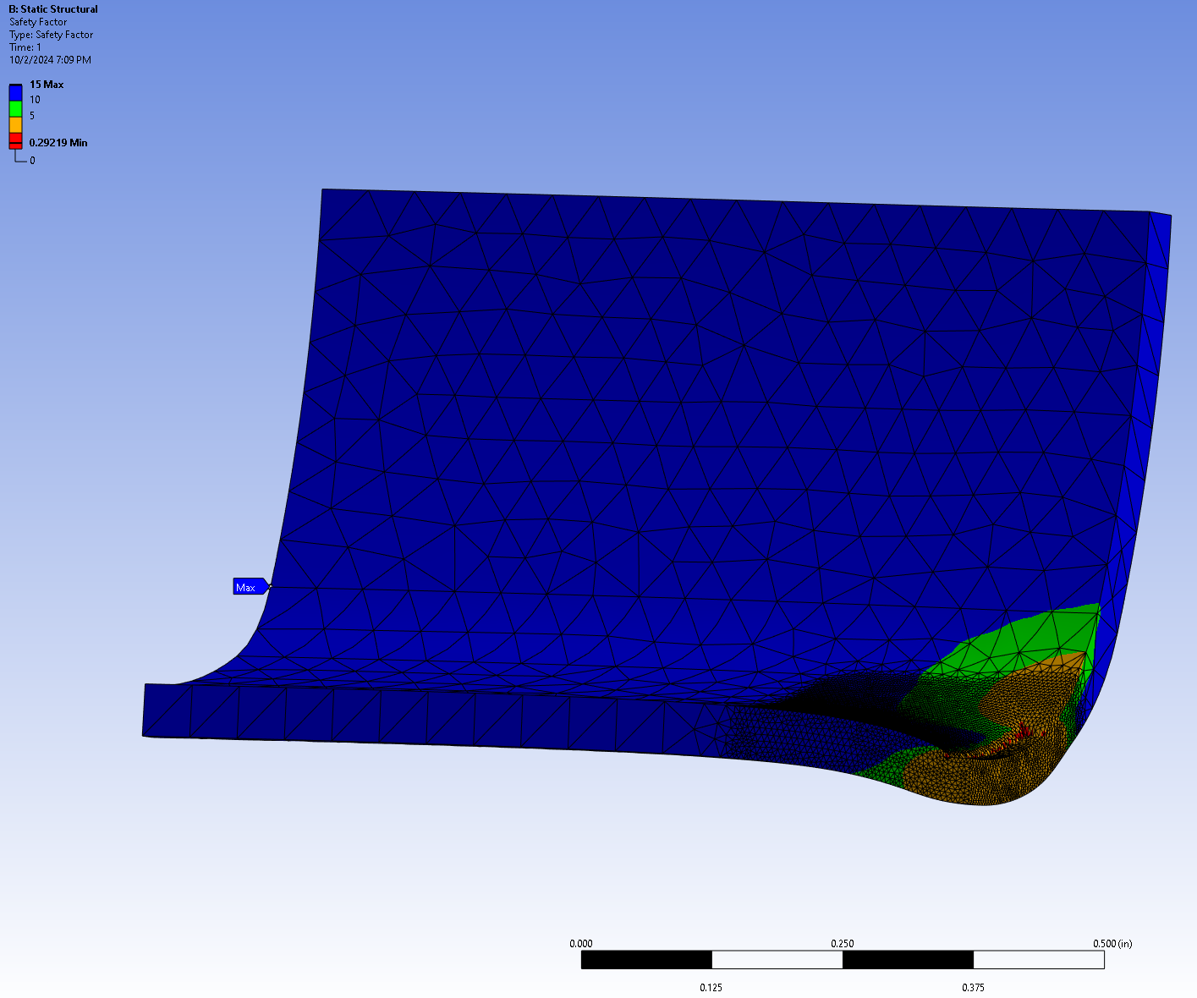
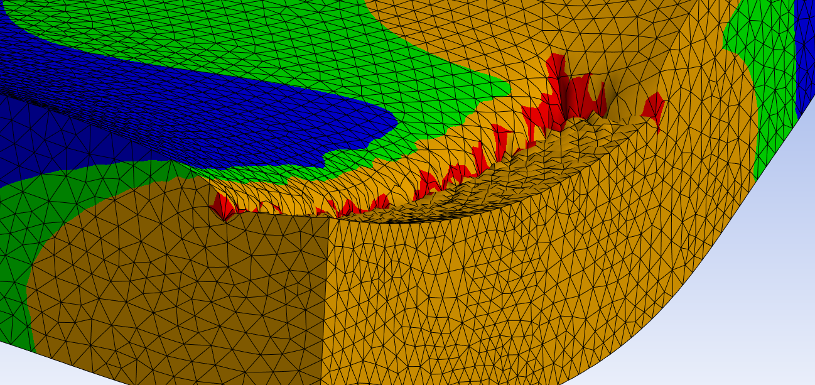
FEA – CV Inserts
Load Case: Launch | Solver: Ansys | Material: Custom 465 | Geometry: Linear
Safety Factor Ultimate: 1.4 | Safety Factor Yield: 1.1 | Temperature: 71.6 F | Notes:
Section | Max Stress | Failure Mode | Material | Yield Allowable (with knockdowns) | Ultimate Allowable (with knockdowns) | MS_Yield | MS_Ultimate | Jacobian Ratio (Gauss Points) Avg | Aspect Ratio Avg
 |  |  | Steel | 181 ksi |  |  |  | 0.99987 | 1.7889

Slide 59
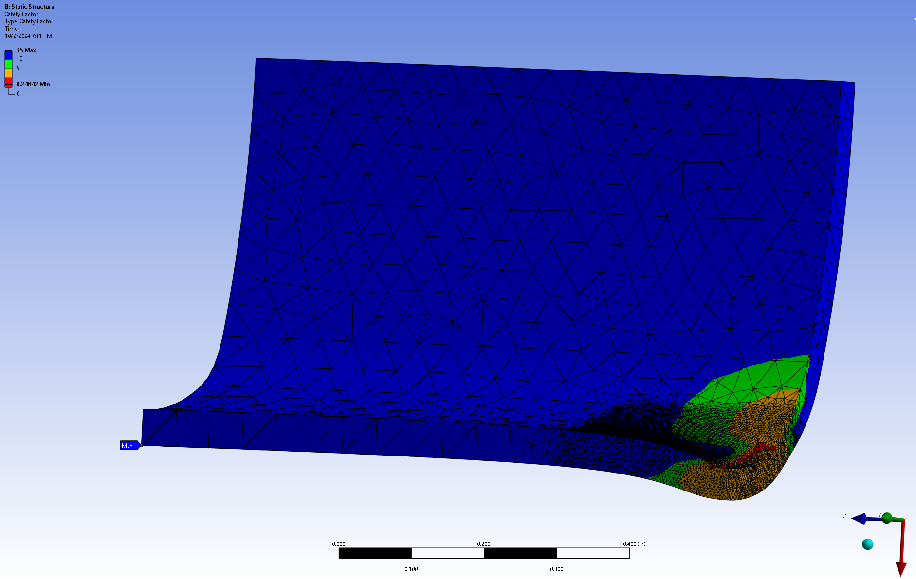
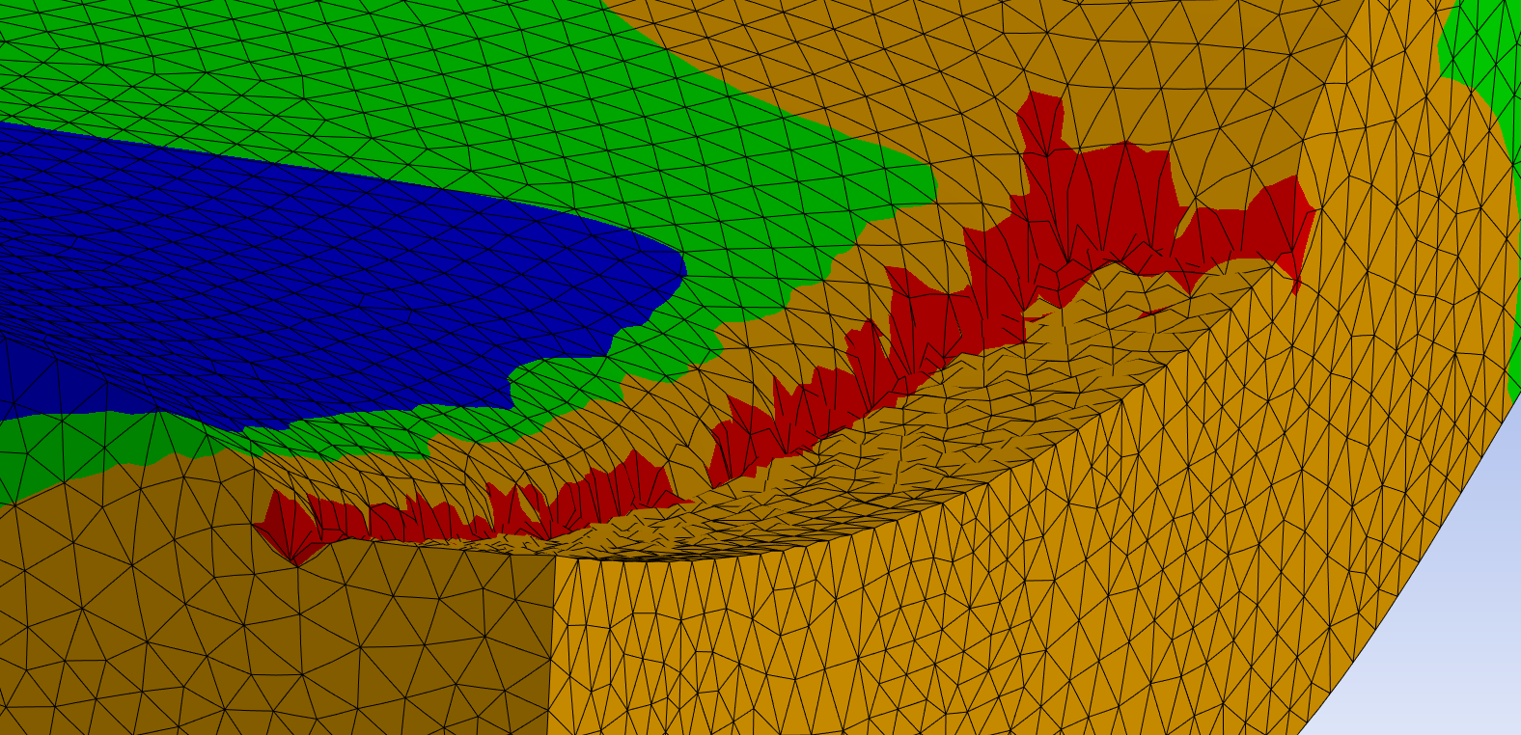
FEA – CV Inserts
Load Case: Launch | Solver: Ansys | Material: Custom 465 | Geometry: Linear
Safety Factor Ultimate: 1.4 | Safety Factor Yield: 1.1 | Temperature: 71.6 F | Notes:
Section | Max Stress | Failure Mode | Material | Yield Allowable (with knockdowns) | Ultimate Allowable (with knockdowns) | MS_Yield | MS_Ultimate | Jacobian Ratio (Gauss Points) Avg | Aspect Ratio Avg
 |  |  | Steel | 181 ksi |  |  |  | 0.99987 | 1.7889

Slide 60
FEA – Diff Carriers (Individual)
Setup:
Turnbuckle modelled as spring with stiffness calculated
Cylindrical Support on Bottom Node
Bearing Load
Load applied onto a mock bearing face to simulate a bearing load going through the part
Testing for equivalent stress, shear stress, deformation, and eigenvalue buckling

Slide 61
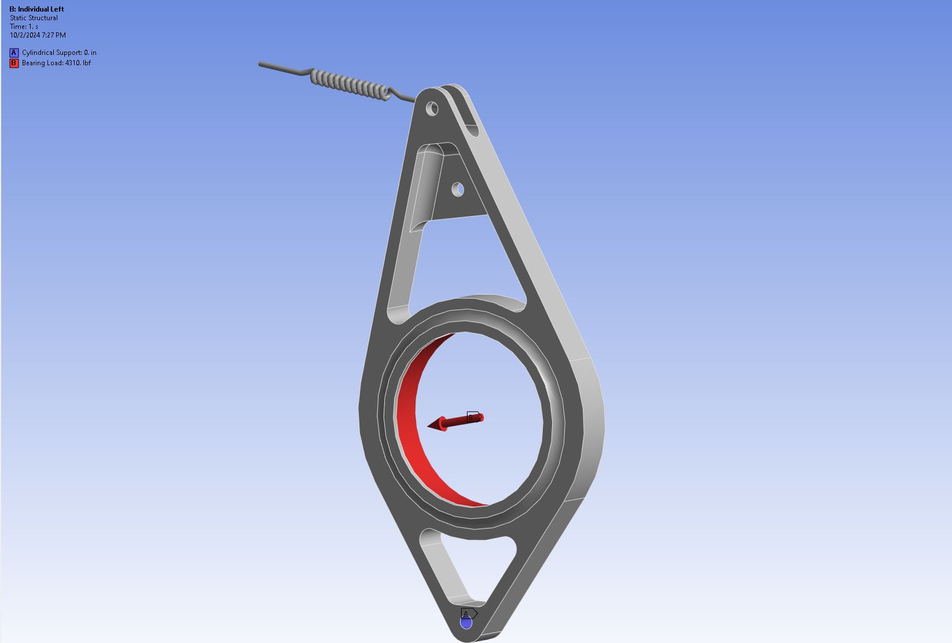
FEA – Diff Carriers (Individual)

Slide 62
FEA – Diff Carriers
Mesh:
Mesh convergence not carried out for this one
Peak stresses remain in similar spots so it is better to run a coarser mesh all around and a sphere of influence where there is peak stress (usually the bottom fillet)
Settings:
General element size at 0.1 in
SOI element size at 0.02 in
Ran at the bottom fillet for both
Note:
Mass is not fully optimized
Eigenvalue buckling not ran due to length of time running on lab computers
Combined setup not run due to issues with individual right case
Ran once, went to change a relatively normal parameter, sends carrier’s stress to basically infinity… something I have to investigate before I can run a combined case (I did both carriers exact same way, so any input would help here)

Slide 63
FEA – Diff Carriers (Combined)
Setup:
Turnbuckles modelled as spring with stiffness calculated
Cylindrical Support on Bottom Nodes
Bearing Loads
Load applied onto a mock bearing face to simulate a bearing load going through the part
Testing for overall system stresses and reaction probes to get bolt and lug calcs

Slide 64
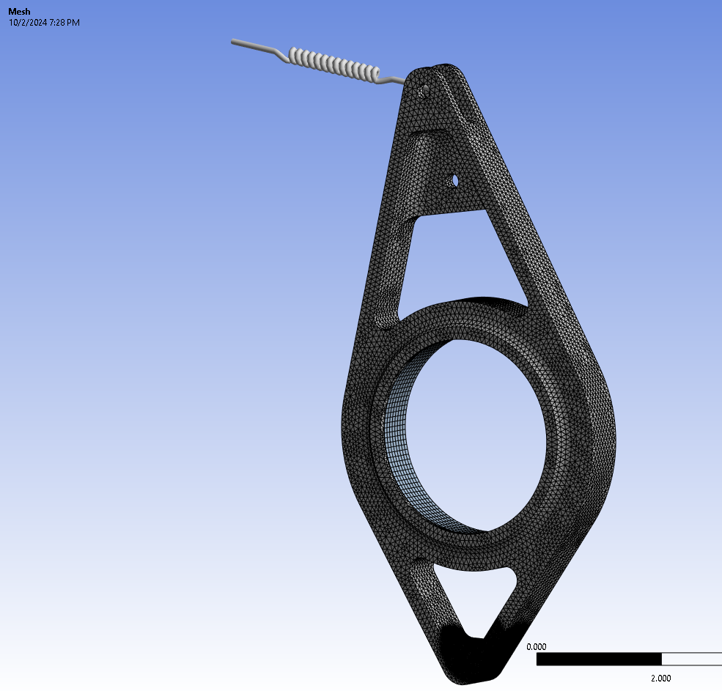
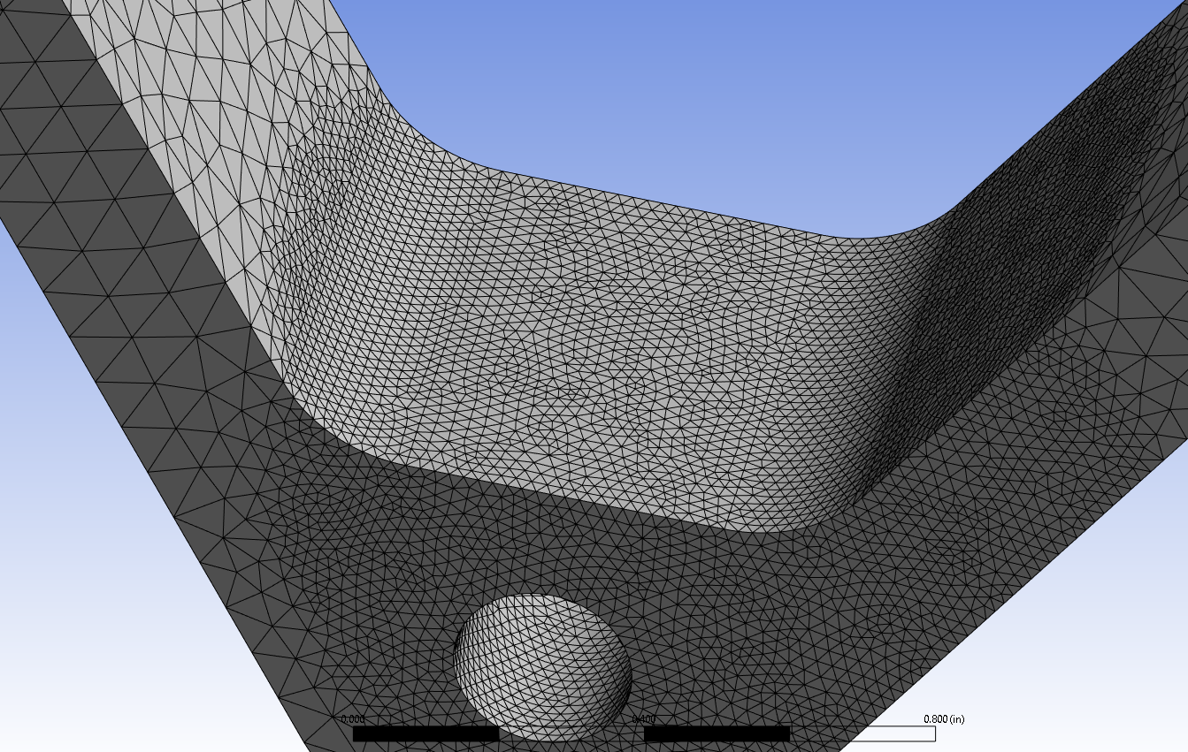
FEA – Diff Carriers

Slide 65
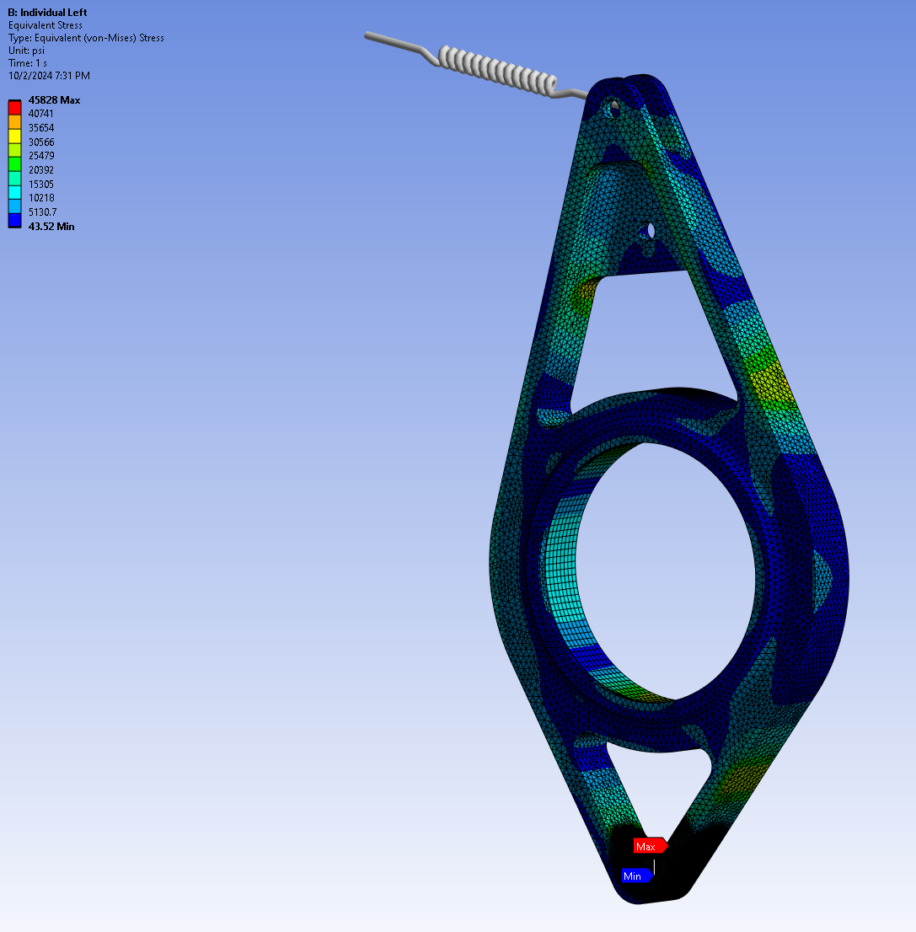
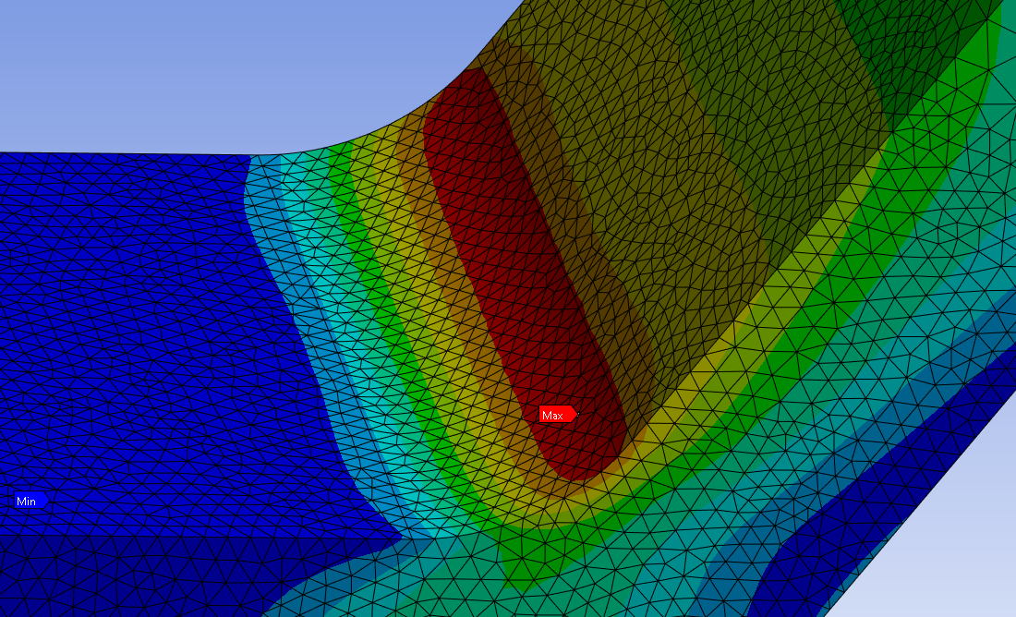
FEA – Left Carrier (Individual)
Load Case: LC | Solver: Ansys | Material: Al 7055-T77511 | Geometry: Linear
Safety Factor Ultimate: 1.4 | Safety Factor Yield: 1.2 | Temperature: 71.6 F | Notes:
Section | Max Stress | Failure Mode | Material | Yield Allowable (with knockdowns) | Ultimate Allowable (with knockdowns) | MS_Yield | MS_Ultimate | Jacobian Ratio (Gauss Points) Avg | Aspect Ratio Avg
 |  |  | Al | 61600 psi | 57000 psi |  |  | 0.99854 | 1.8052

Slide 66
FEA – Sprocket
Notes
FEA ran without splined section to ease meshing
Calculations carried out on spline stress calculator as previously defined
Loading from tooth table applied onto first 7 teeth
Represented under 5% of the max load that is seen
Ran sim using first 13 teeth, but proved to be no more useful than 7 in terms of peak stresses obtained

Slide 67
FEA – Sprocket
Setup:
First seven tooth forced modeled as point loads on surface of tooth
Frictionless supports on the sides
Cylindrical support where spline would be
Changed from PDR (based on IDR feedback)
Sprocket is fixed relative to the differential, but the differential is free to rotate. Thus, a cylindrical support was recommended

Slide 68
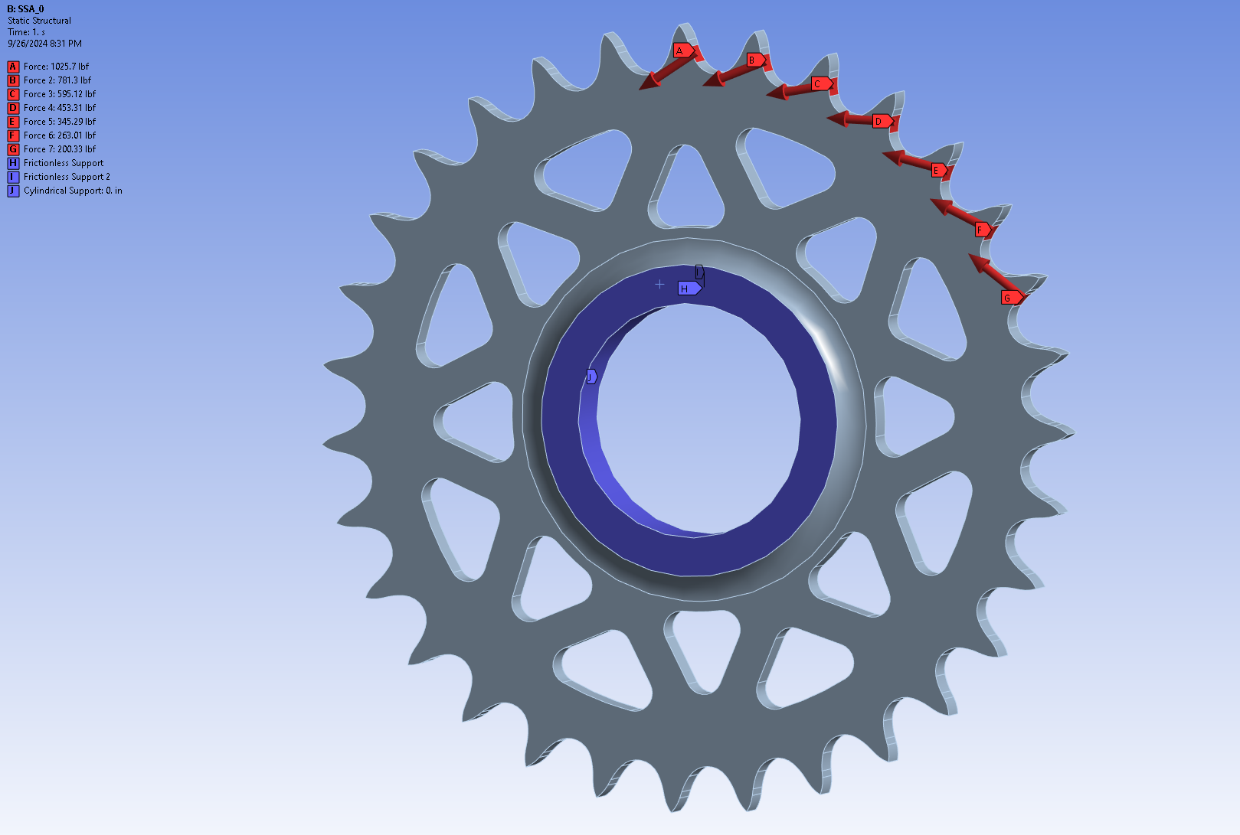
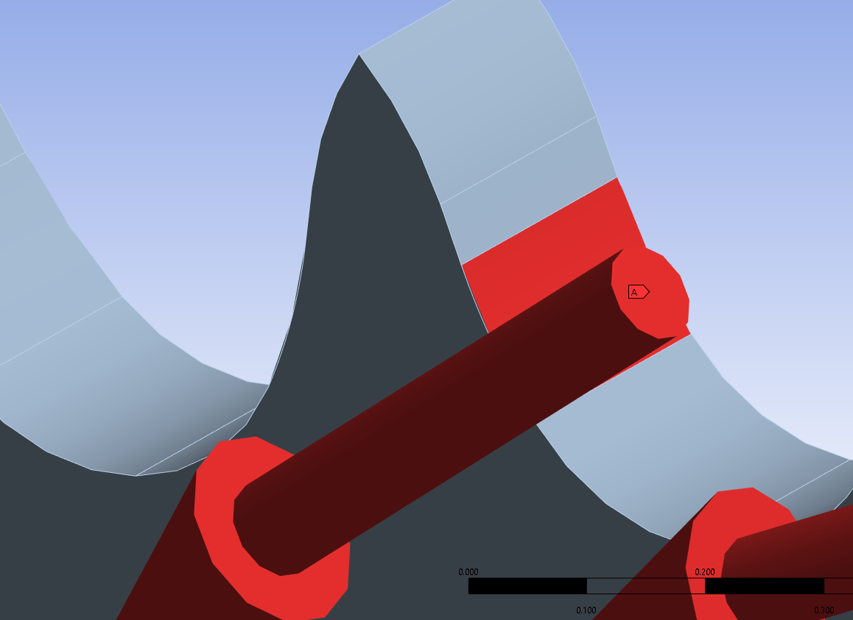
FEA – Sprocket

Slide 69
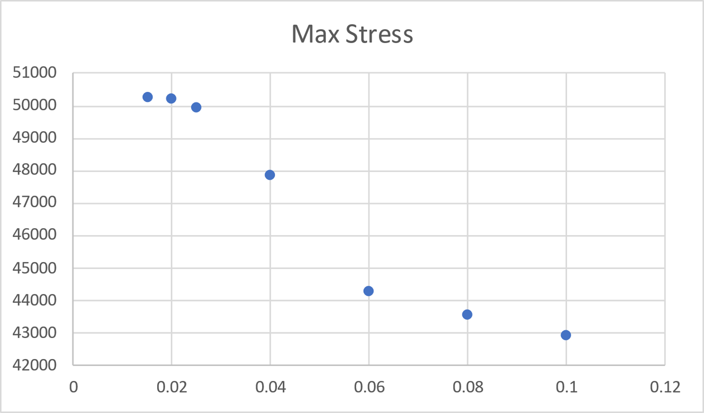
FEA – Sprocket
Mesh Convergence Study:
Element size changed to perform study
Element Size | Max Stress
0.1 | 42946
0.08 | 43621
0.06 | 44311
0.04 | 47911
0.025 | 49960
0.02 | 50242
0.015 | 50283

Slide 70
FEA – Sprocket
Final Mesh Parameters:
General:
Element Size – 0.025 in
Ran SOI where needed
Decided on upon results from mesh convergence study
Element Order – Program Controlled
Patch Conforming Method
Tetrahedrons
Patch Conforming Algorithm
Quadratic Element Order

Slide 71
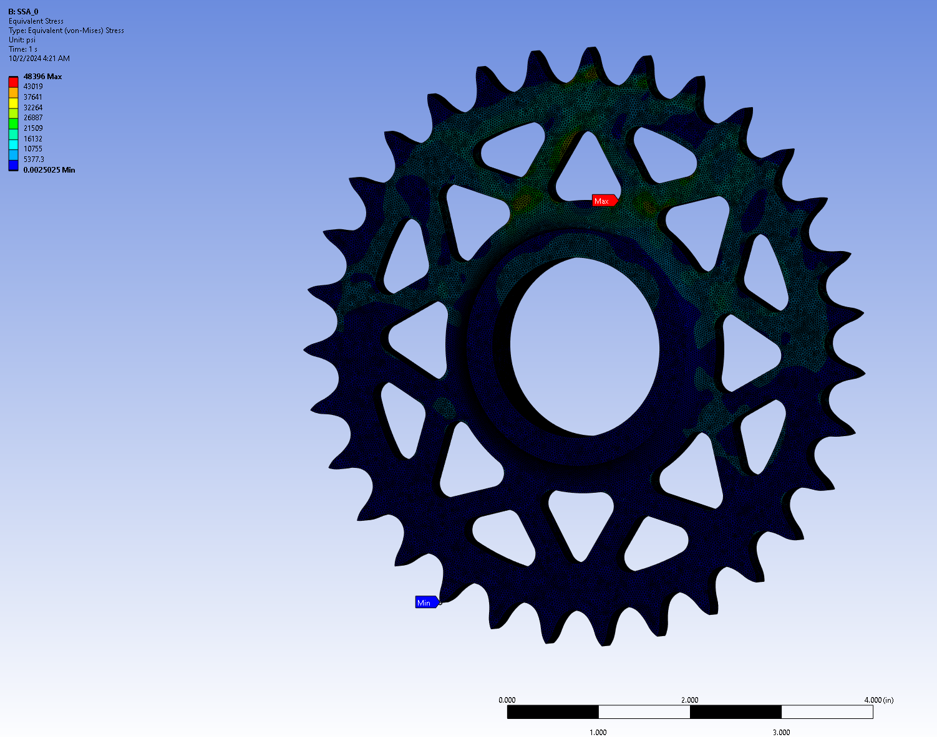
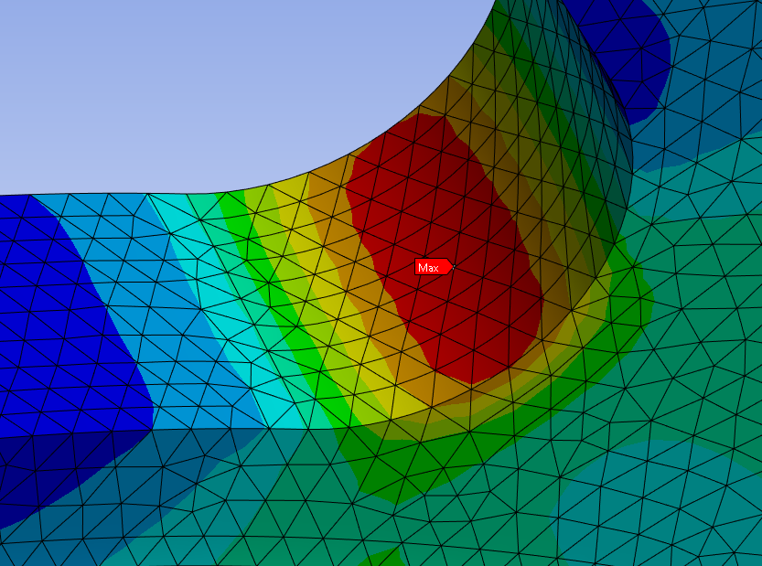
FEA – Sprocket SSA_0
Load Case: SSA_0 | Solver: Ansys | Material: Al 7055-T77511 | Geometry: Linear
Safety Factor Ultimate: 1.4 | Safety Factor Yield: 1.2 | Temperature: 71.6 F | Notes:
Section | Max Stress | Failure Mode | Material | Yield Allowable (with knockdowns) | Ultimate Allowable (with knockdowns) | MS_Yield | MS_Ultimate | Jacobian Ratio (Gauss Points) Avg | Aspect Ratio Avg
 | 43896 psi |  | Al | 61600 psi | 57000 psi |  |  | 0.99844 | 1.8946

Slide 72
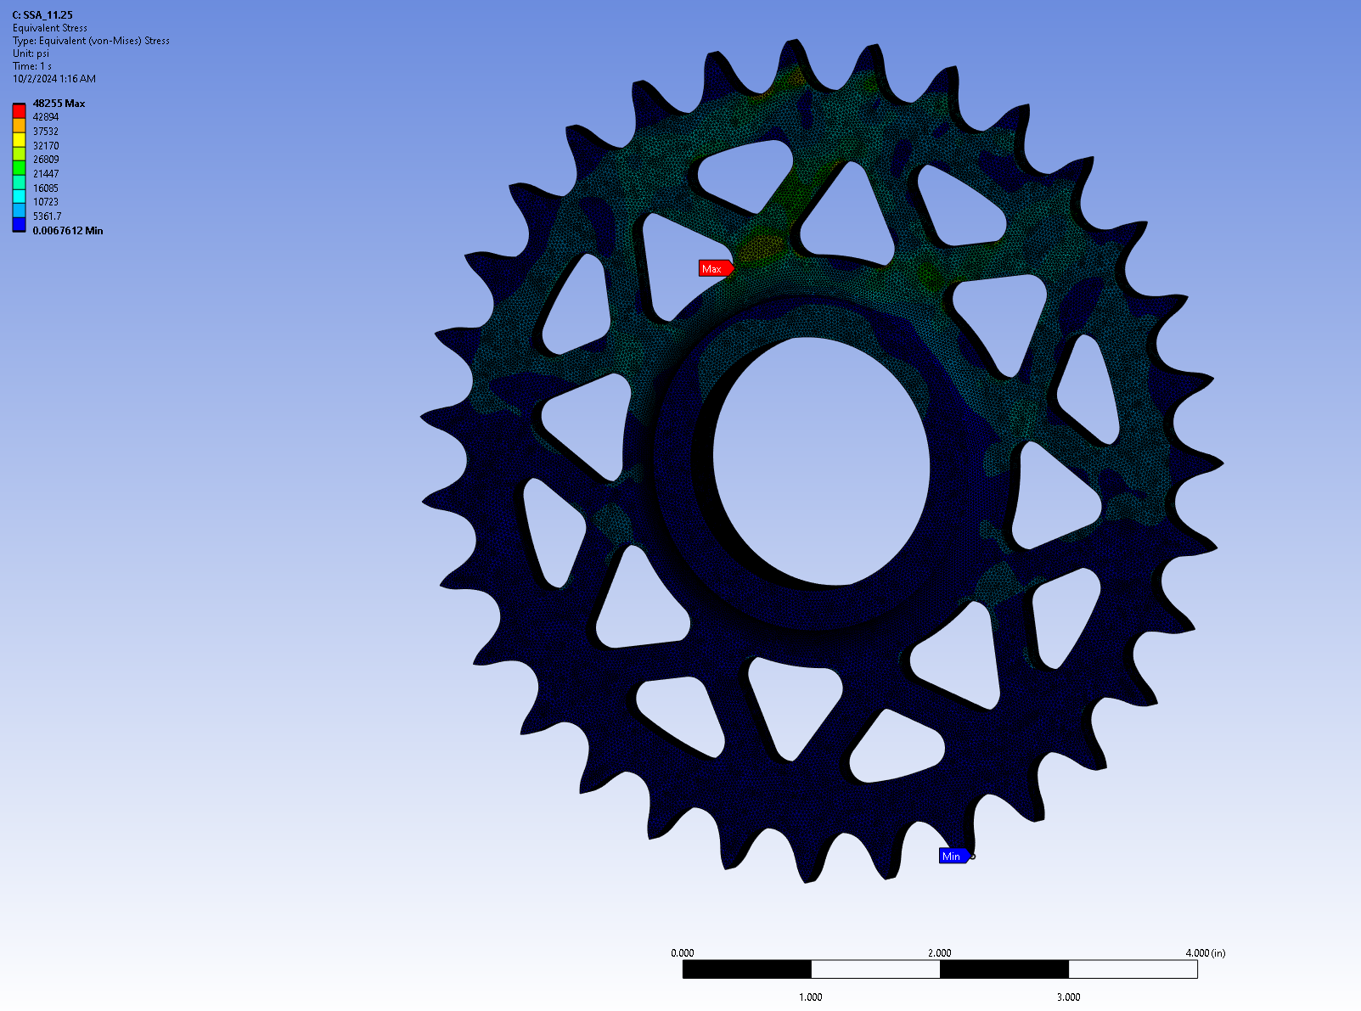
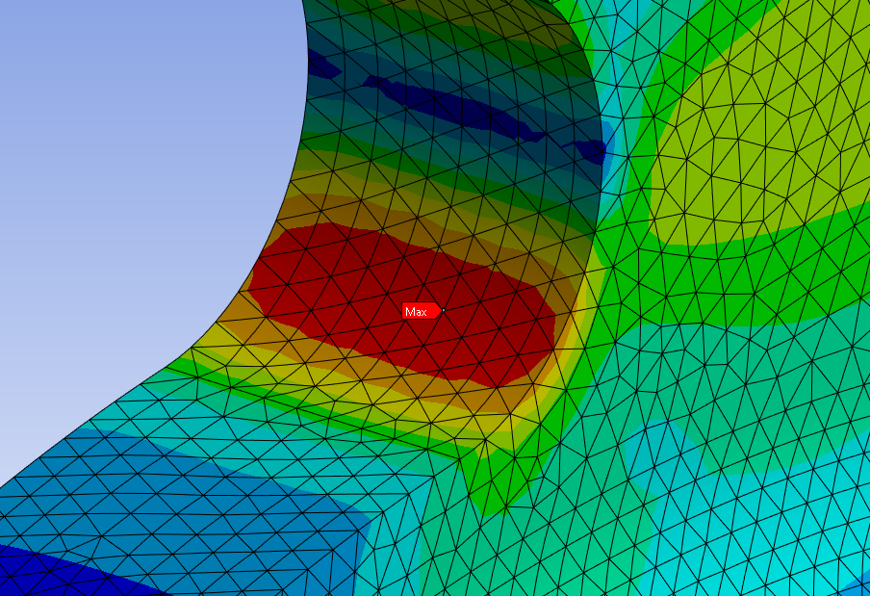
FEA – Sprocket SSA_11.25
Load Case: SSA_11.25 | Solver: Ansys | Material: Al 7055-T77511 | Geometry: Linear
Safety Factor Ultimate: 1.4 | Safety Factor Yield: 1.2 | Temperature: 71.6 F | Notes:
Section | Max Stress | Failure Mode | Material | Yield Allowable (with knockdowns) | Ultimate Allowable (with knockdowns) | MS_Yield | MS_Ultimate | Jacobian Ratio (Gauss Points) Avg | Aspect Ratio Avg
 | 48255 psi |  | Al | 61600 psi | 57000 psi |  |  | 0.99843 | 1.8941

Slide 73
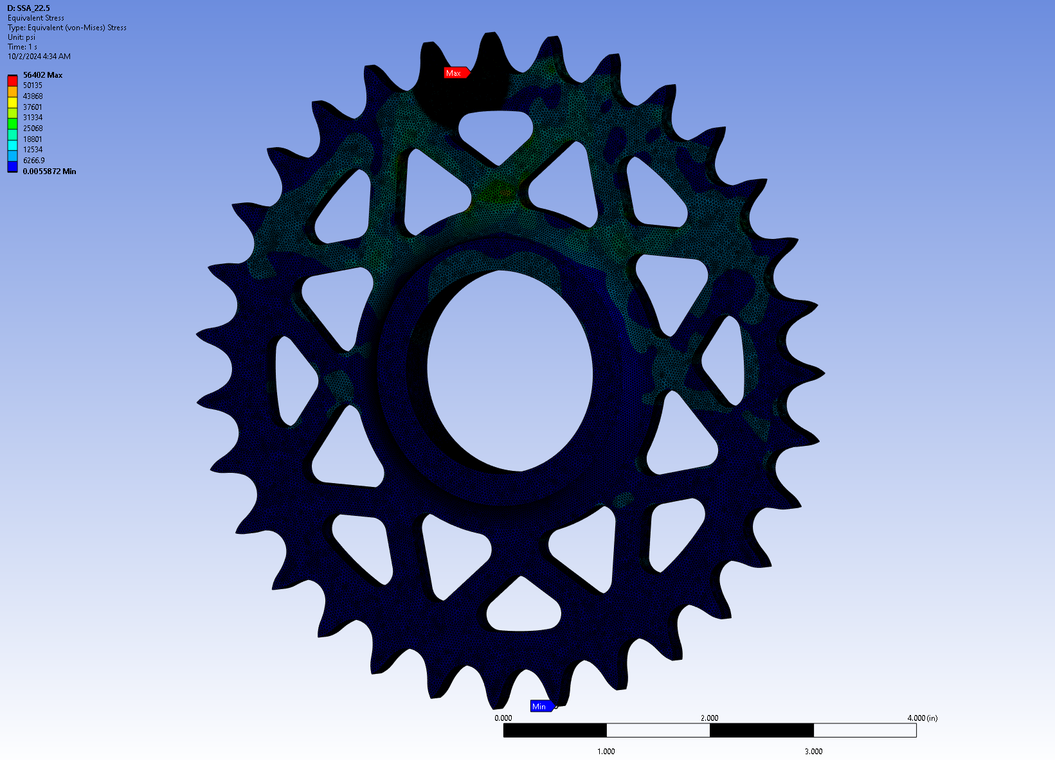
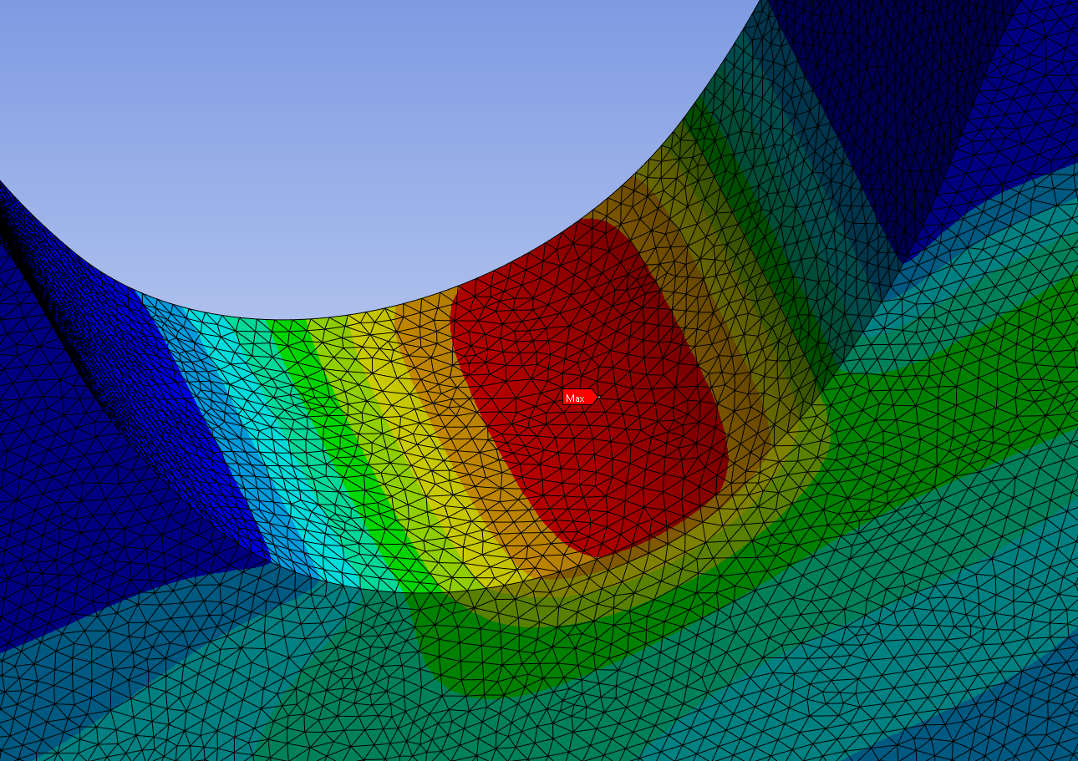
FEA – Sprocket SSA_22.5
Load Case: SSA_22.5 | Solver: Ansys | Material: Al 7055-T77511 | Geometry: Linear
Safety Factor Ultimate: 1.4 | Safety Factor Yield: 1.2 | Temperature: 71.6 F | Notes: Ran SOI
Section | Max Stress | Failure Mode | Material | Yield Allowable (with knockdowns) | Ultimate Allowable (with knockdowns) | MS_Yield | MS_Ultimate | Jacobian Ratio (Gauss Points) Avg | Aspect Ratio Avg
 | 56402 psi |  | Al | 61600 psi | 57000 psi |  |  | 0.99905 | 1.8477

Slide 74
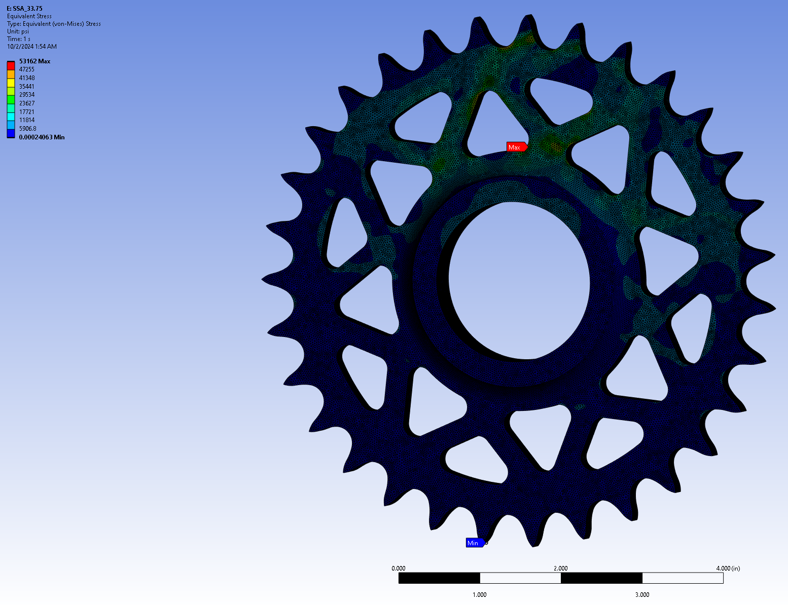
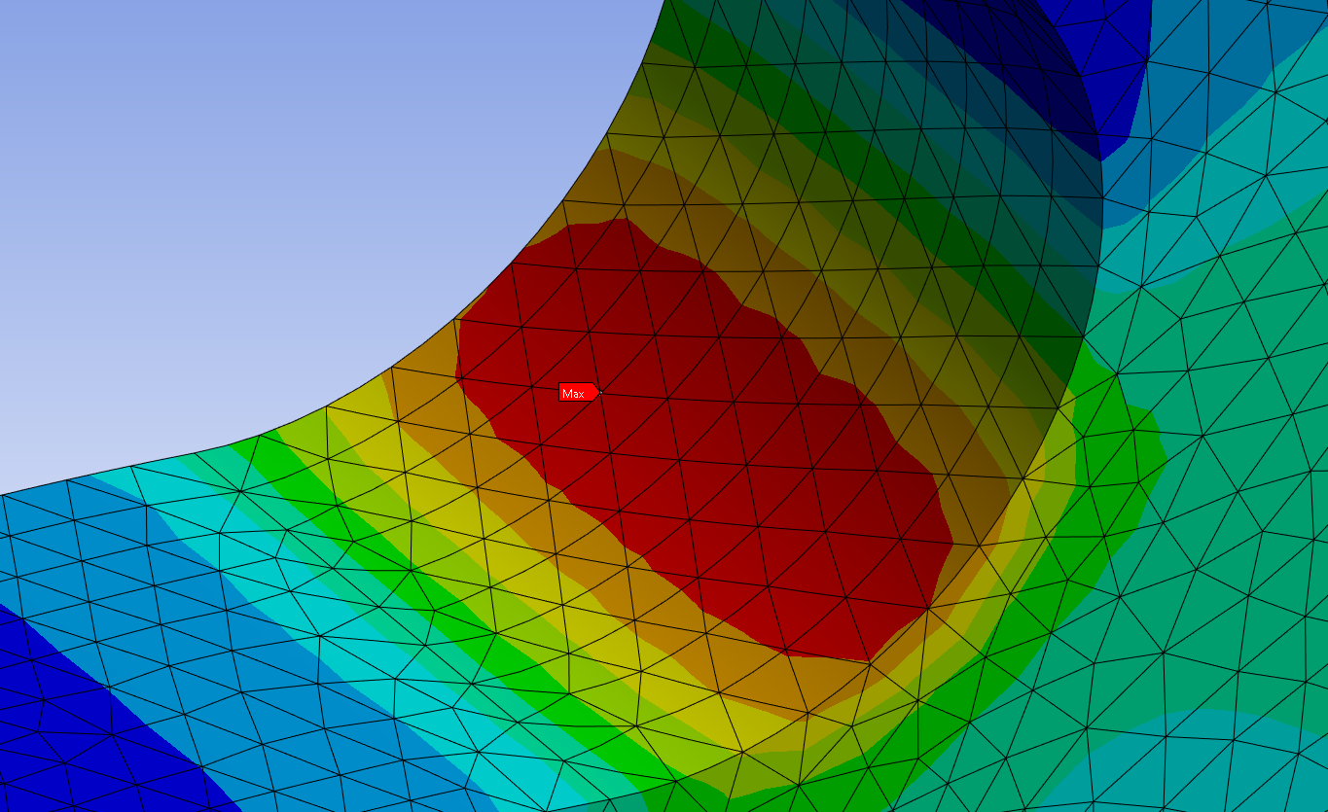
FEA – Sprocket SSA_33.75
Load Case: SSA_33.75 | Solver: Ansys | Material: Al 7055-T77511 | Geometry: Linear
Safety Factor Ultimate: 1.4 | Safety Factor Yield: 1.2 | Temperature: 71.6 F | Notes:
Section | Max Stress | Failure Mode | Material | Yield Allowable (with knockdowns) | Ultimate Allowable (with knockdowns) | MS_Yield | MS_Ultimate | Jacobian Ratio (Gauss Points) Avg | Aspect Ratio Avg
 | 53162 psi |  | Al | 61600 psi | 57000 psi |  |  | 0.99844 | 1.894

Slide 75
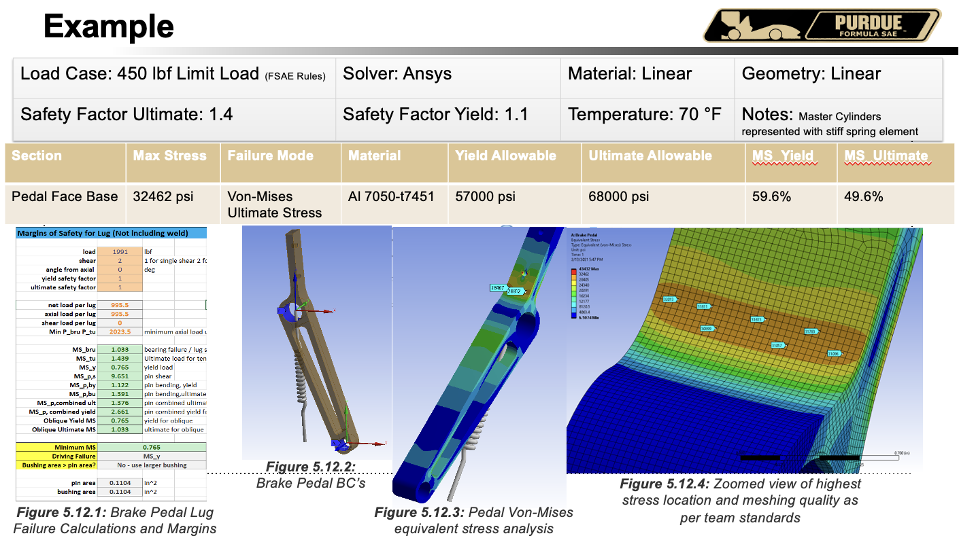
FEA Template
Load Case: | Solver: Ansys | Material: | Geometry:
Safety Factor Ultimate: | Safety Factor Yield: | Temperature: | Notes:
Section | Max Stress | Failure Mode | Material | Yield Allowable (with knockdowns) | Ultimate Allowable (with knockdowns) | MS_Yield | MS_Ultimate | Jacobian Ratio (Gauss Points) Avg | Aspect Ratio Avg
Insert pictures of setup, overall stress plots, and close up shots of large stresses

Slide 76
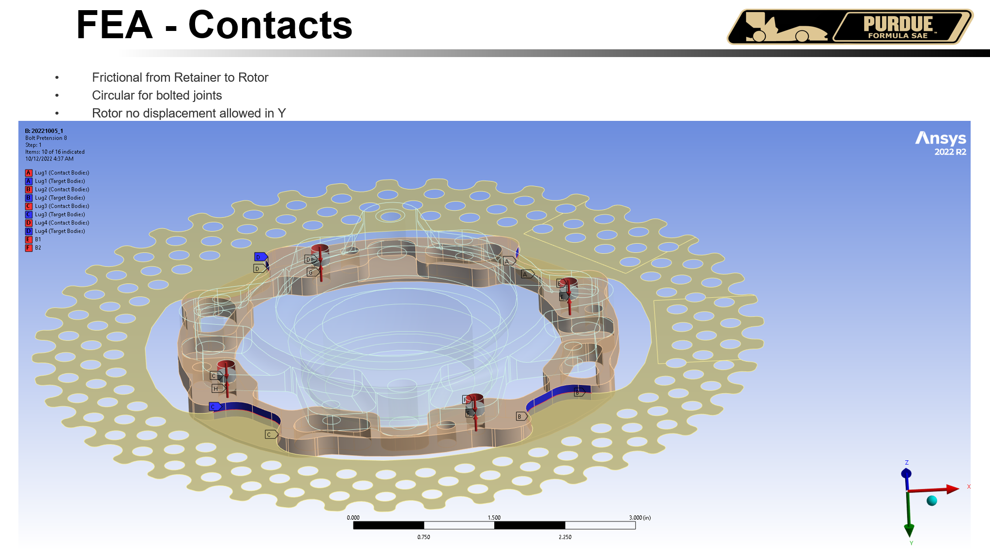
Example FEA
Use entire slides to illustrate setup and results for ease of viewing.

Slide 77
Manufacturing

Slide 78
Manufacturing - Sprocket
Stock Prep
Cut to round ~ 7” OD
Thickness = 0.625”
Wire EDM
Spline section
Operation 1 – Manual Lathe
Machine down OD to ~0.2” past the tip of the teeth
Machine down thickness to 0.5”
Machine down part to make basic profile with no teeth or cutouts
Operation 2 – CNC Lathe
Cut teeth and cutouts
Operation 3 – Post Processing
Filing
Type II Hard Ano

Slide 79
Manufacturing - Carriers
Stock Prep
Cut to size
Operation 1 – CNC
Type II Hard Ano
Operation 2 – Cut rodend slots
Mill to appropriately sized dimension and tolerancing (0.001) for a tight fit
Operation 3 – Boring
Operation 4 – Press fit bearings
Exact fits are a bit tbd at the moment

Slide 80
Manufacturing – Turnbuckles
Acquire stock
Operation 1 – Cut to size
Use lathe and cut to size based on CAD dimensions
Operation 2 – Tap threaded holes

Slide 81
Manufacturing – CV Inserts
Acquire stock
Operation 1 – Cut to size/face if needed
Operation 2 – Wire EDM
HT not needed on PF25 as it will come heat treated

Slide 82
Manufacturing – Chain Guard
Acquire stock
Operation 1 – Laser cut to appropriate size
Operation 2 – Bend
Either use a CNC roller or hammer and torch

Slide 83
“Manufacturing” - Halfshaft
Acquire Halfshaft from RCV
Measure lengths on car
Operation 1 – Cut to Length
Cut to as measured length on car (not necessarily same as CAD)
Operation 2 – Cut Grooves for O-rings

Slide 84
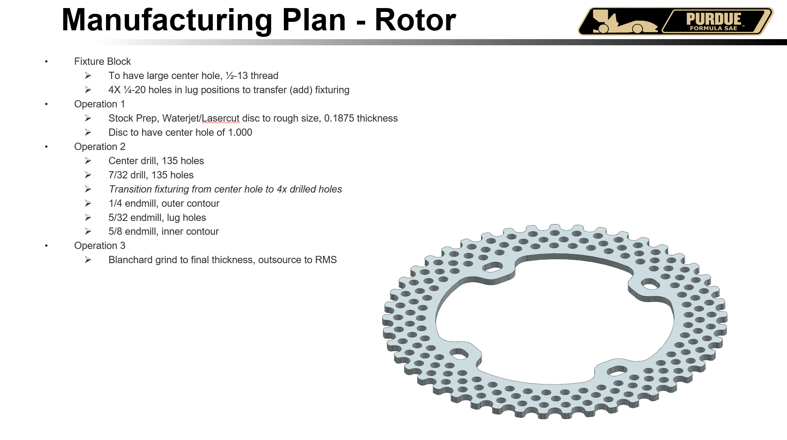
Manufacturing
Outline the methods intended to be used to manufacture your system
This should be exhaustive (see example)

Slide 85
Cost

Slide 86
Cost
Major Component | Owned/Sponsored/Purchased | Estimated Cost + Misc Notes
Drexler Salisbury LSD | Owned | $3000
Halfshafts | Purchased | $300 x 2
Tripods | Purchased | $115 x 4
Diff Carrier Bearings | Sponsored (SKF, NTN) | $150 x 4
Inboard CV (Tulip) Housings | Owned | $750
Aluminum Stock | Sponsored (Arconic) | $1000
Chain | Purchased | $100 x 2-3
Hardware | Purchased | $250
Total Estimated Cost (excluding owned and sponsored parts) | $1610
Note: This is preliminary as I am still working through design and analysis. This is a rough estimate.

Slide 87
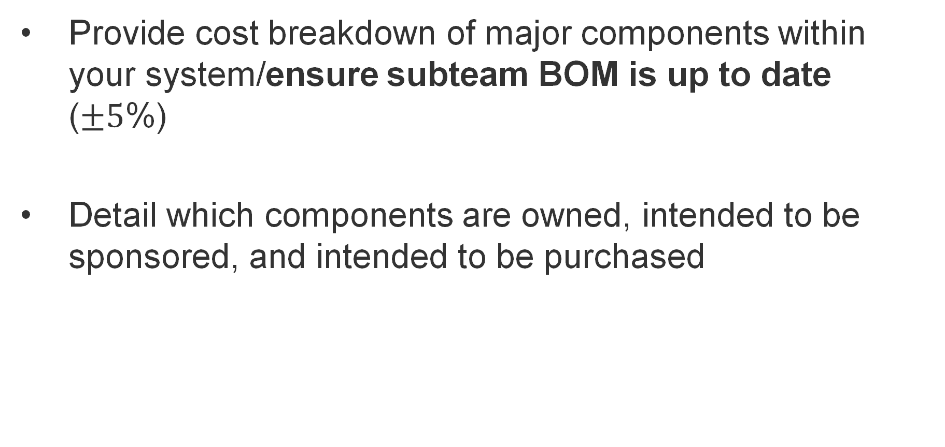
Cost
Provide cost breakdown of major components within your system/ensure subteam BOM is up to date ($±5$%)
Detail which components are owned, intended to be sponsored, and intended to be purchased

